Slide 1
7. Viewing
Computer Graphics

Slide 2
Reading
Hearn & Baker, Chapter 6, 7
Angel, Chapter 5
Watt, Chapter 5

Slide 3
Contents
3D viewing pipeline
3D viewing-coordinate parameters
Transformation from world to viewing coordinates
Projection transformations
Orthogonal projections
Oblique parallel projections
Perspective projections
Viewport transformation and 3D screen coordinates

Slide 4
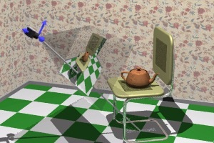
3D Viewing Pipeline
General processing steps for creating and transforming a 3D scene to device coordinates
the scene is modeled in world coordinates
the description of the scene is converted to viewing coordinates
the viewing-coordinate description of the scene is converted to coordinate positions on the projection plane
objects are mapped to normalized coordinates and all parts of the scene outside the view volume are clipped off
viewport coordinates are mapped to device coordinates within a selected display window
Modeling Transform
Viewing Transform
Projection/Normalize Transform
Viewport Transform
MC
WC
CC
NC
SC

Slide 5
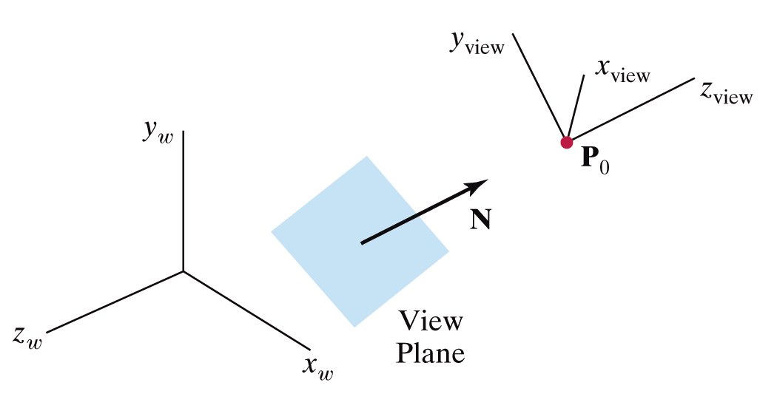
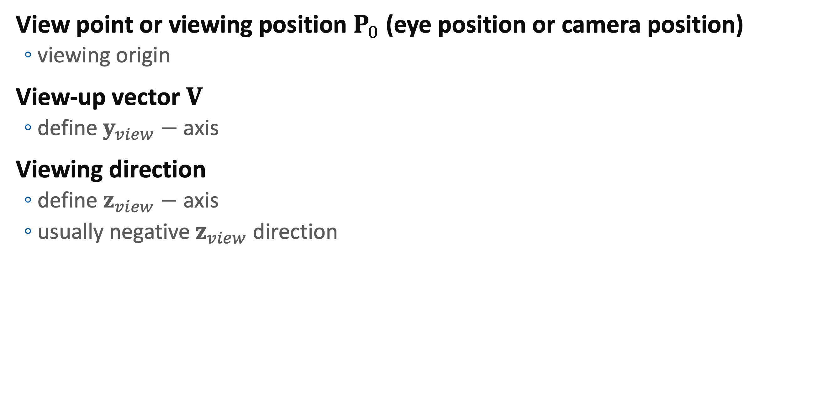
3D Viewing-Coordinate Parameters
View point or viewing position $P_{0}$ (eye position or camera position)
viewing origin
View-up vector $V$
define $y_{view}−$ axis
Viewing direction
define $z_{view}−$ axis
usually negative $z_{view}$ direction

Slide 6
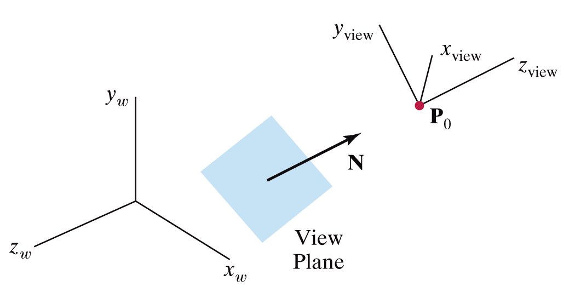


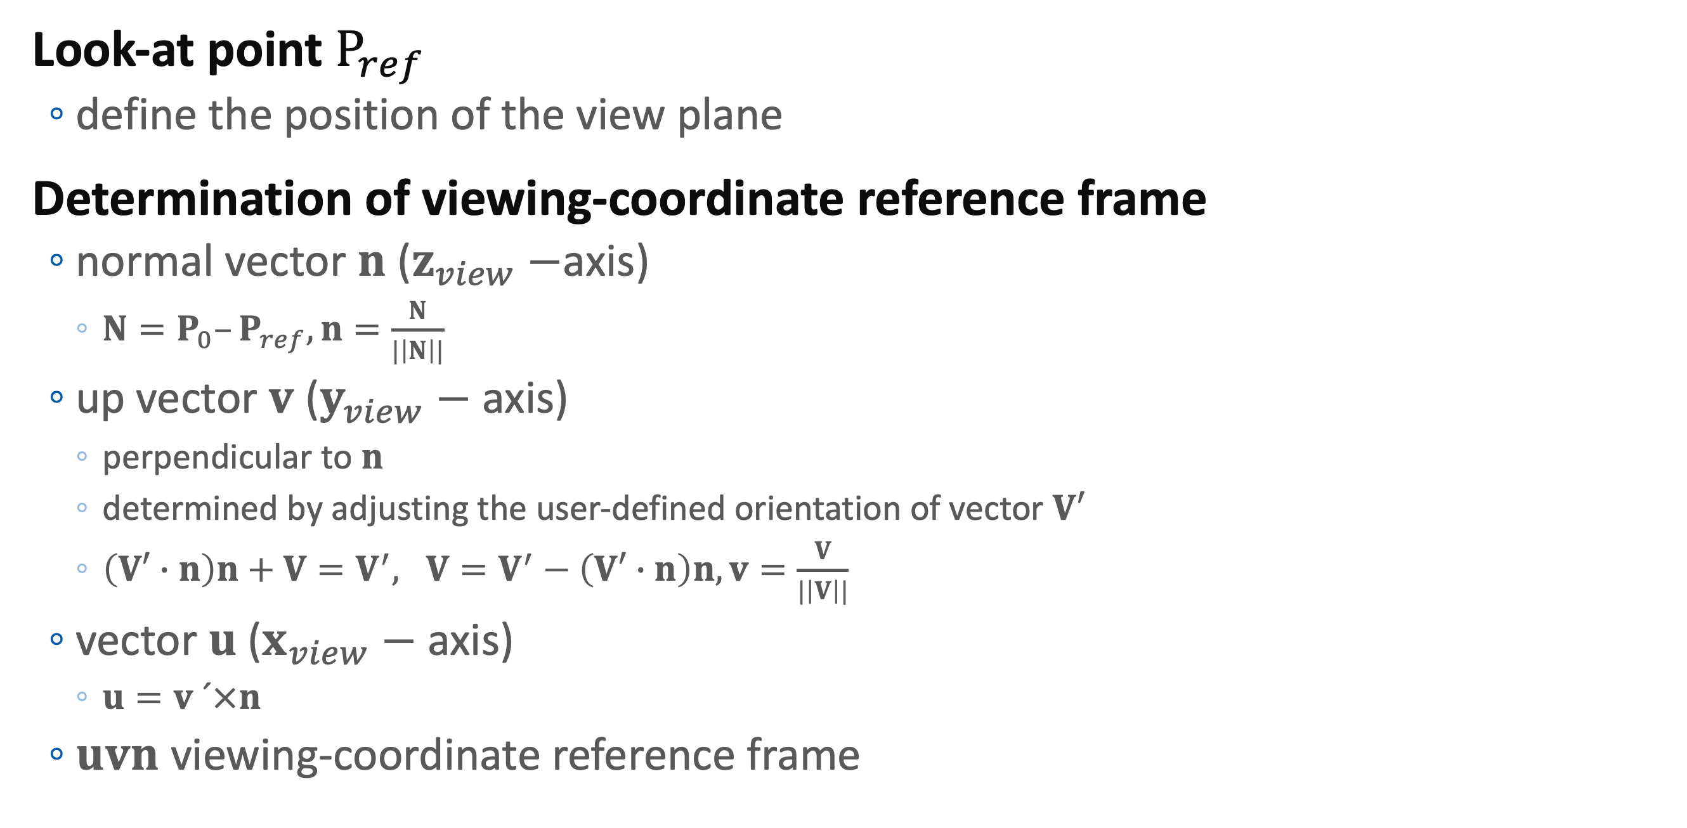
3D Viewing-Coordinate Parameters
Look-at point $P_{ref}$
define the position of the view plane
Determination of viewing-coordinate reference frame
normal vector $n$ ($z_{view}−$axis)
$N=P_{0}–P_{ref}, n=\frac{N}{|\left|N\right||}$
up vector $v$ ($y_{view}−$ axis)
perpendicular to $n$
determined by adjusting the user-defined orientation of vector $V′$
$\left(V′∙n\right)n+V=V^{′}, V=V^{′}−\left(V′∙n\right)n, v=\frac{V}{|\left|V\right||}$
vector $u$ ($x_{view}−$ axis)
$u=v ´×n$
$uvn$ viewing-coordinate reference frame
N
P_{ref}
u

Slide 7
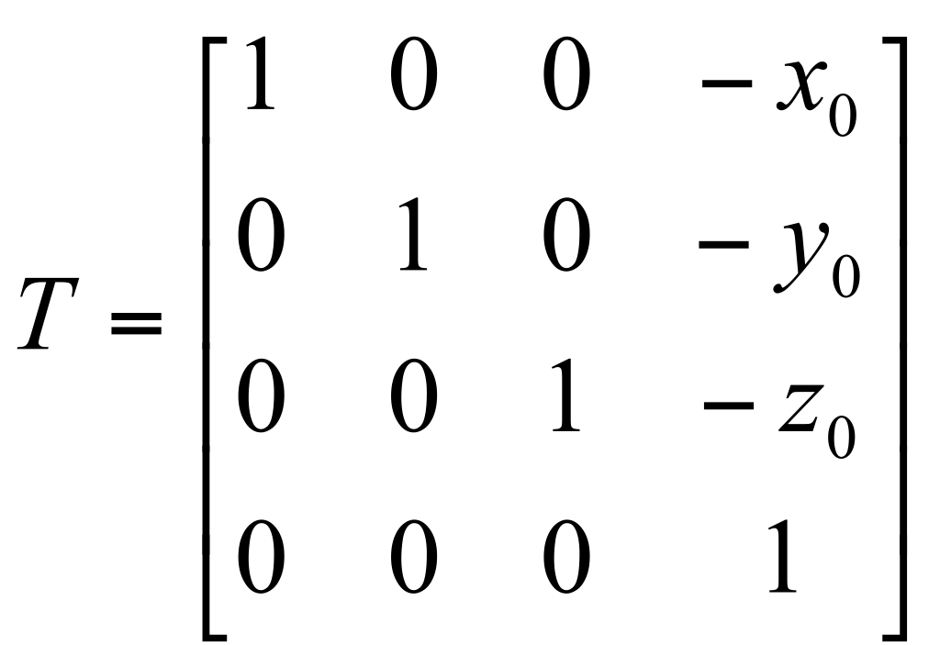
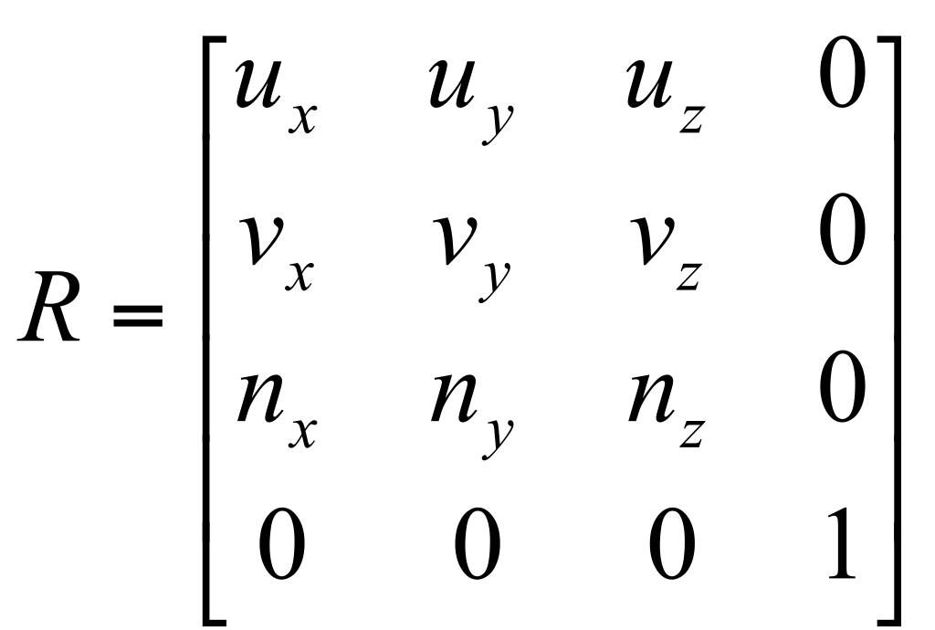
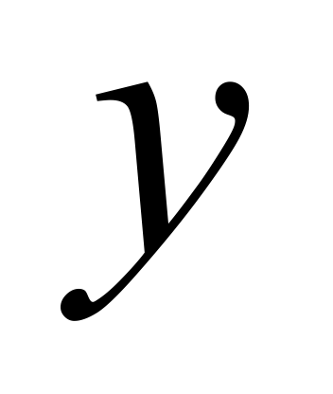


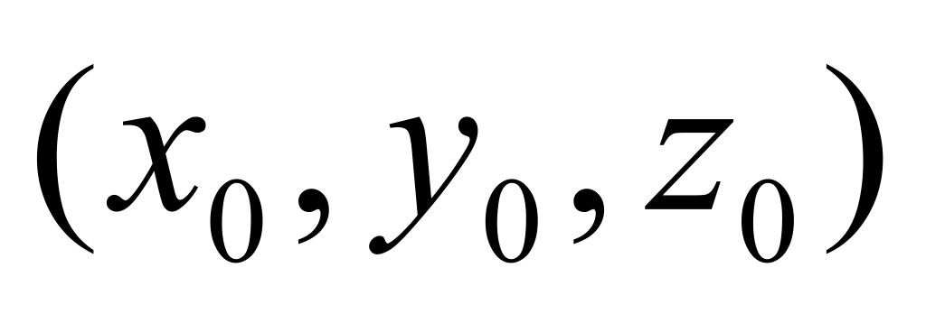
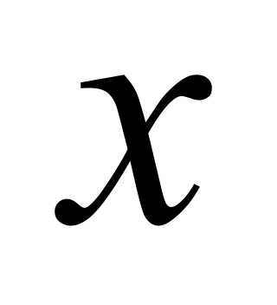


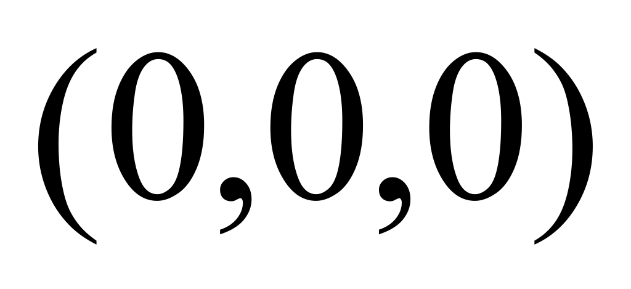
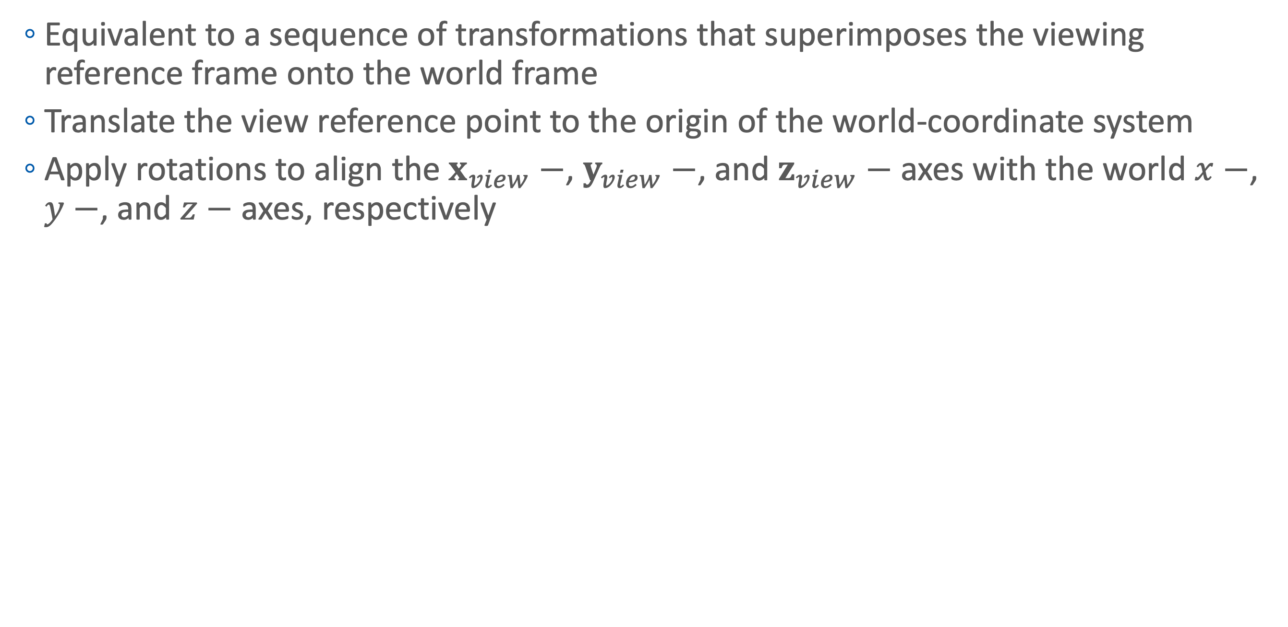
Transformation from World to Viewing Coordinates
Equivalent to a sequence of transformations that superimposes the viewing reference frame onto the world frame
Translate the view reference point to the origin of the world-coordinate system
Apply rotations to align the $x_{view}−$, $y_{view}−$, and $z_{view}−$ axes with the world $x−$, $y−$, and $z−$ axes, respectively

Slide 8
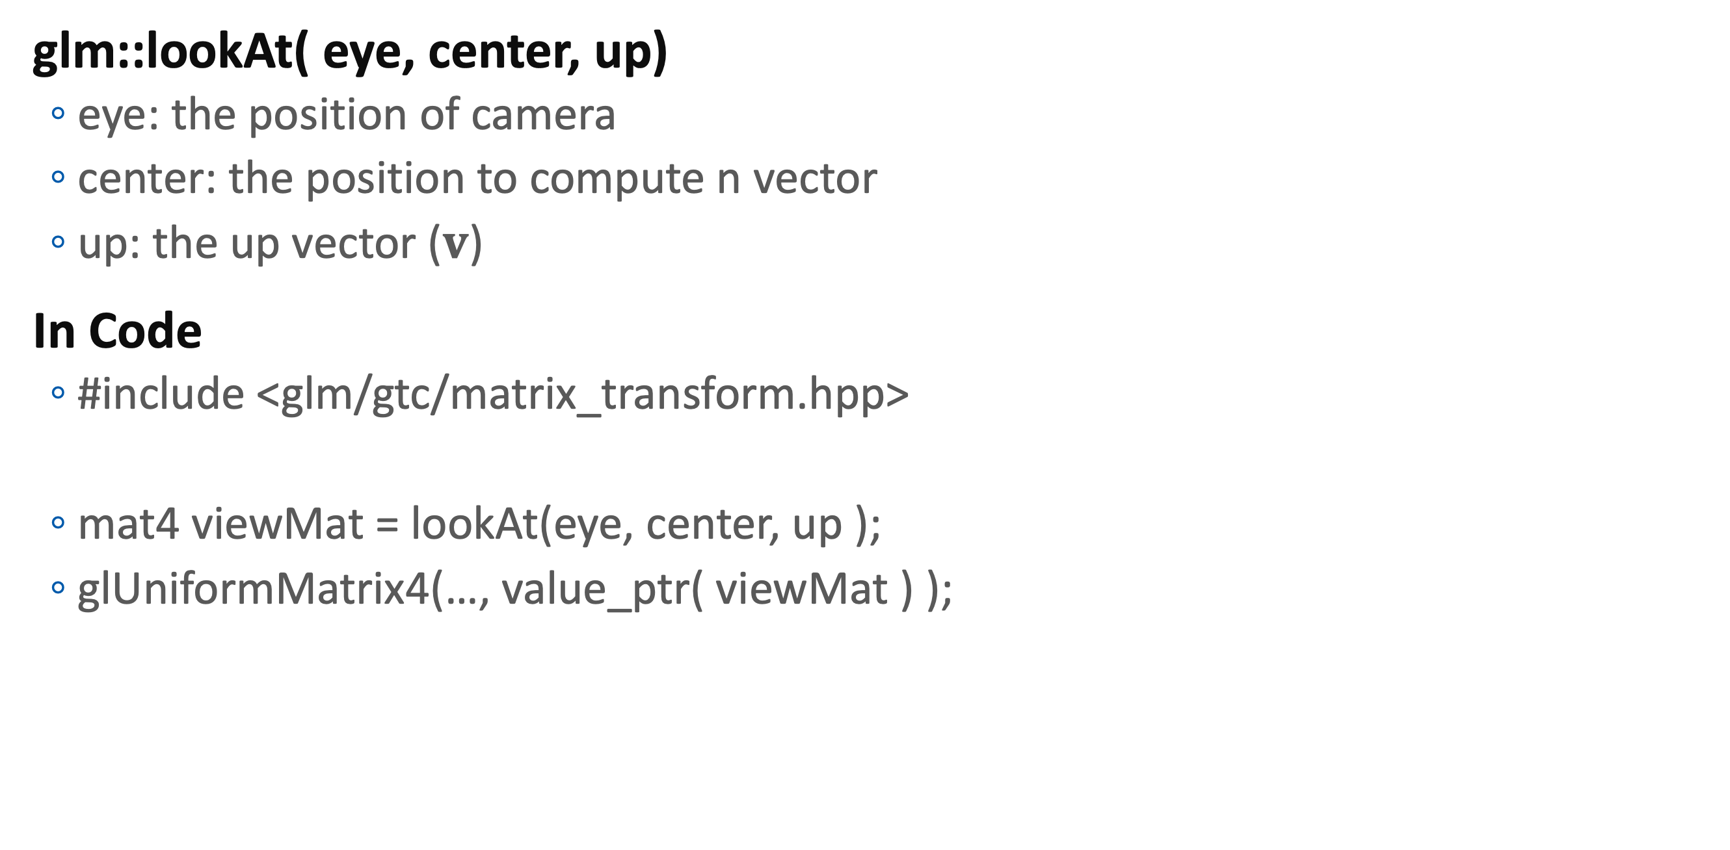
In Practive
glm::lookAt( eye, center, up)
eye: the position of camera
center: the position to compute n vector
up: the up vector ($v$)
In Code
#include <glm/gtc/matrix_transform.hpp>
mat4 viewMat = lookAt(eye, center, up );
glUniformMatrix4(…, value_ptr( viewMat ) );

Slide 9
Camera Rotate Demo
Mouse Handling
glfwSetCursorPosCallback(window, cursorCallback );
glfwSetMouseButtonCallback(window, buttonCallback );
Callback Functions
void cursorCallback( GLFWwindow* window, double x, double y ) {
void buttonCallback( GLFWwindow* window, int button, int action, int mods ) {

Slide 10
Camera Control
Camera Setting (Global variables)
float cameraDistance = 4, cameraPitch = 0, cameraYaw = 0;
Mouse Motion
double lastX, lastY;
Camera Motion
void cursorCallback( GLFWwindow* win, double x, double y ) {
if( glfwGetMouseButton( win, GLFW_MOUSE_BUTTON_1 ) ) {
cameraPitch-=(y-lastY)/200;
cameraYaw -=(x-lastX)/200;
lastX = x;
lastY = y;
}
}

Slide 11
When clicked, set lastX, lastY
void buttonCallback( GLFWwindow* win, int btn, int action, int mods ) {
if( btn == GLFW_MOUSE_BUTTON_1
&& action == GLFW_PRESS ) {
glfwGetCursorPos(win, &lastX, &lastY );
}
}

Slide 12
Compute LookAt Parameters
Center:
vec3(0,0,0)
Camera Position
vec3 cameraPosition = vec3(rotate( cameraYaw, vec3(0,1,0) )
*rotate( cameraPitch, vec3(1,0,0))
*vec4(0,0,cameraDistance,0));
Up-vector
vec3(0,1,0)
Make matrix using glm::lookAt(…)
Set the matrix to vertex shader

Slide 13
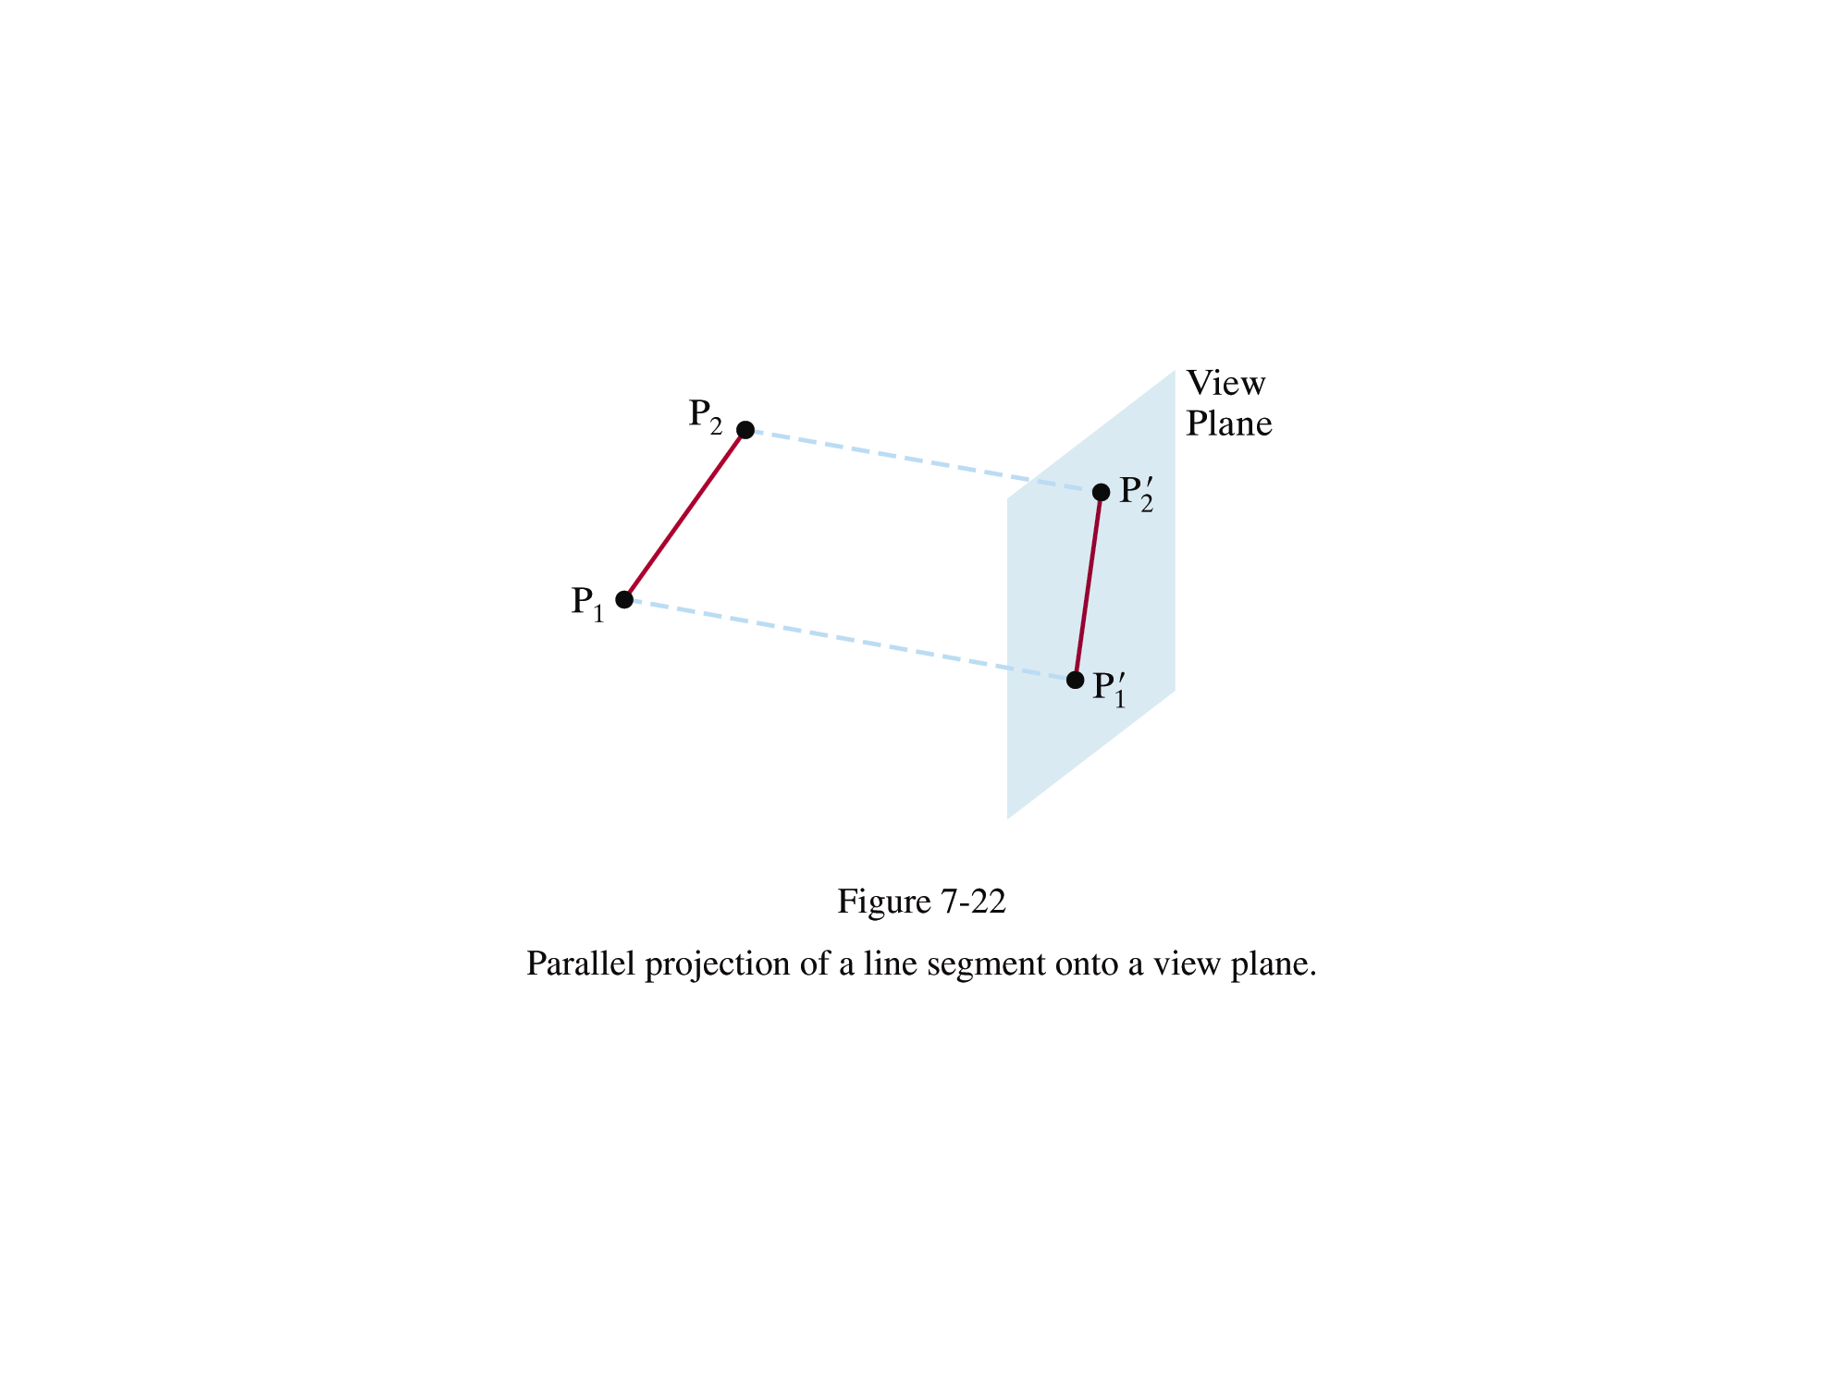
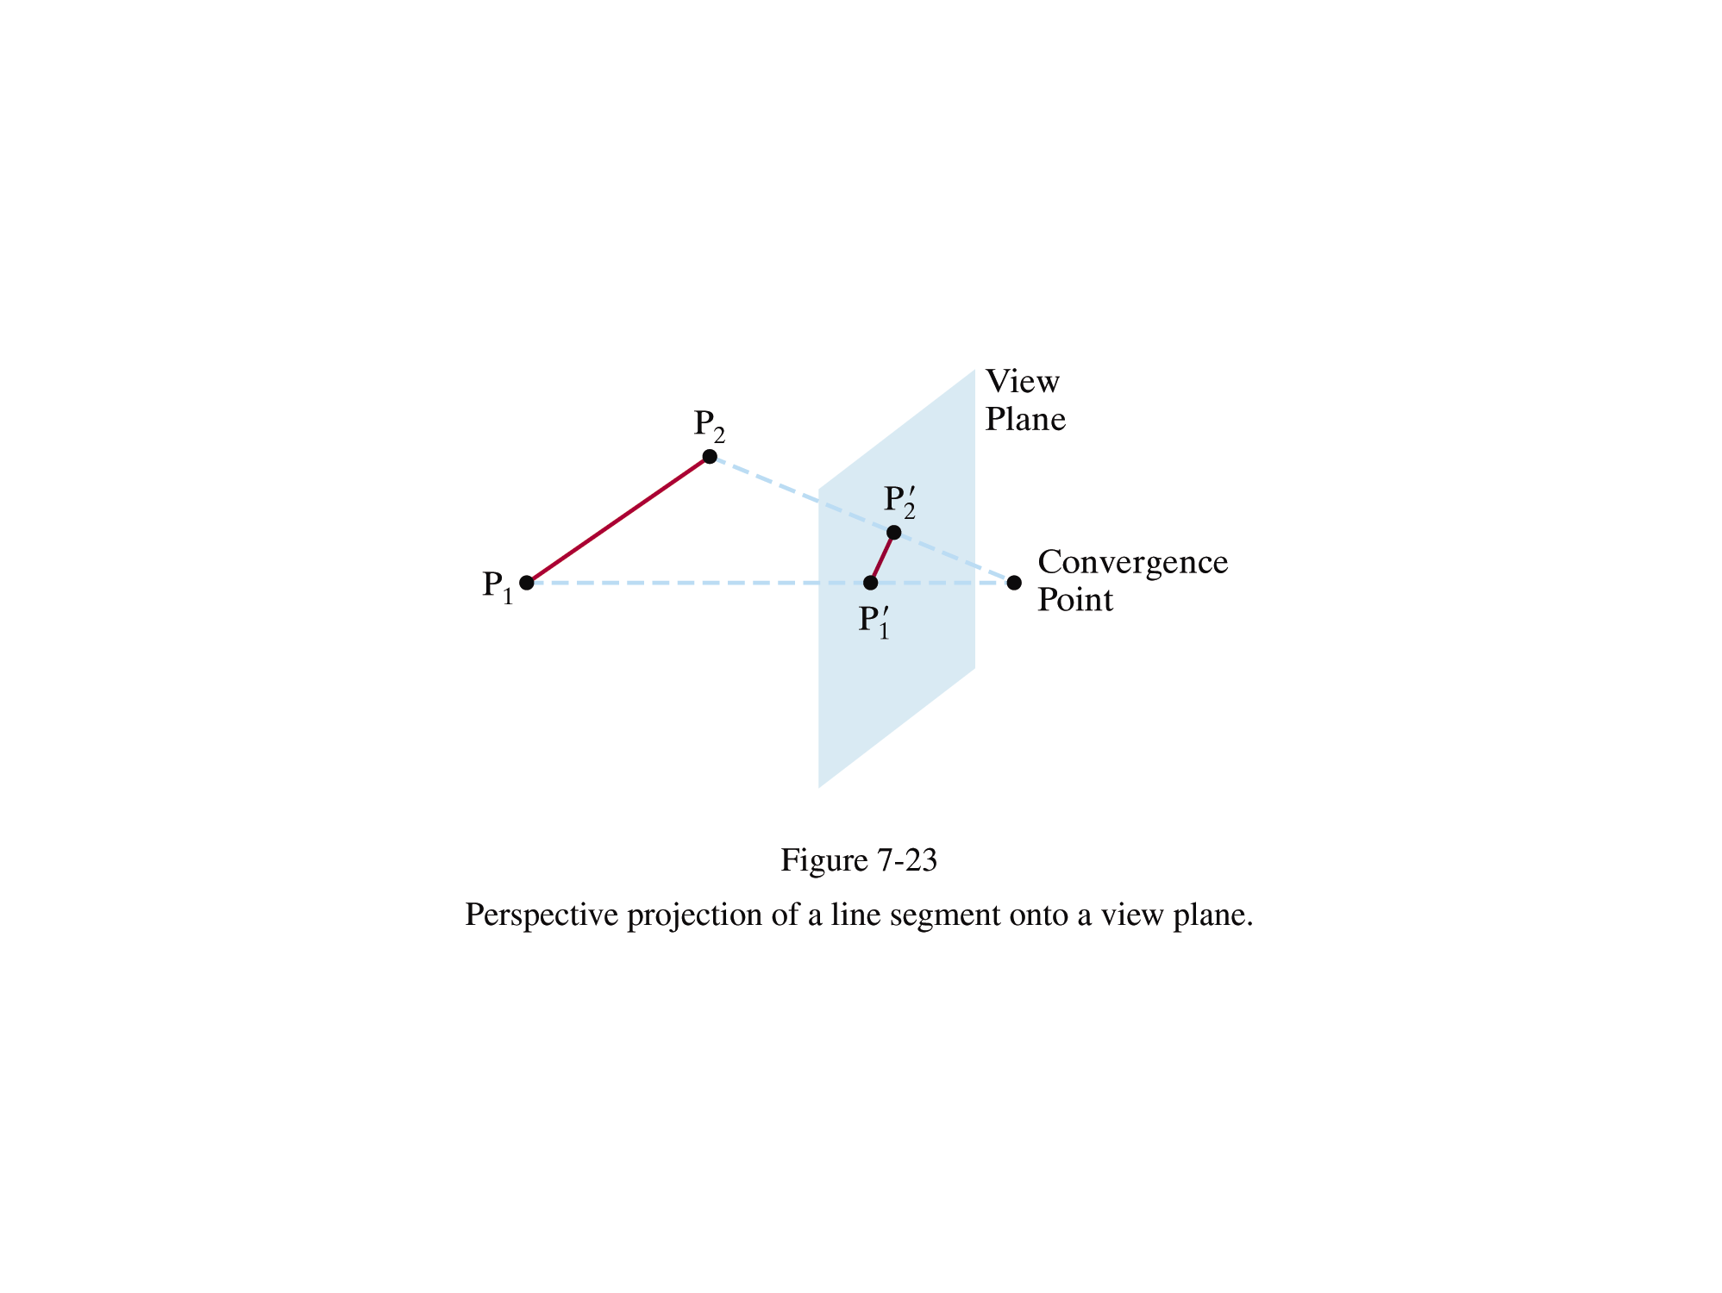
Projection Transformation
Parallel projection
coordinate position are transformed to the view plane along parallel lines
Perspective projection
object positions are transformed to the view plane along lines that converge to a point called the projection reference point (or center of projection)

Slide 14
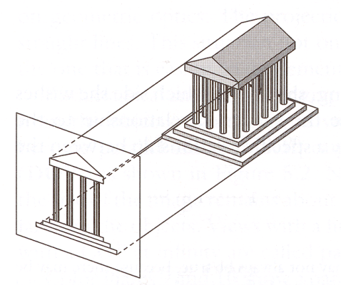
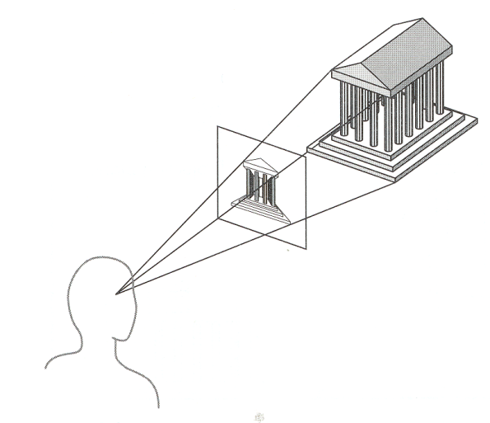
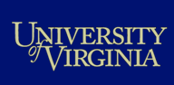
Perspective vs. Parallel
Parallel projection
Good for exact measurements
Parallel lines remain parallel
Angles are not (in general) preserved
Less realistic looking
Perspective projection
Size varies inversely with distance - looks realistic
Distance and angles are not (in general) preserved
Parallel lines do not (in general) remain parallel

Slide 15
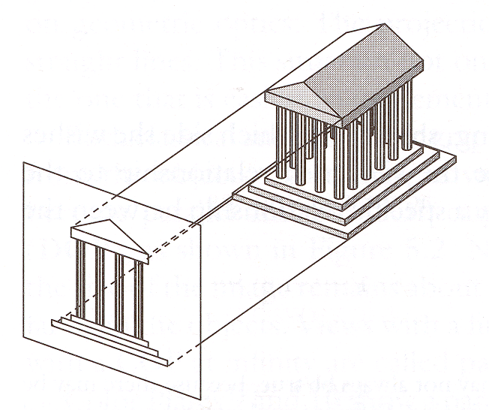
Parallel Projection
Center of projection is at infinity
Direction of projection (DOP) same for all points
View
Plane
DOP
Angel Figure 5.4

Slide 16
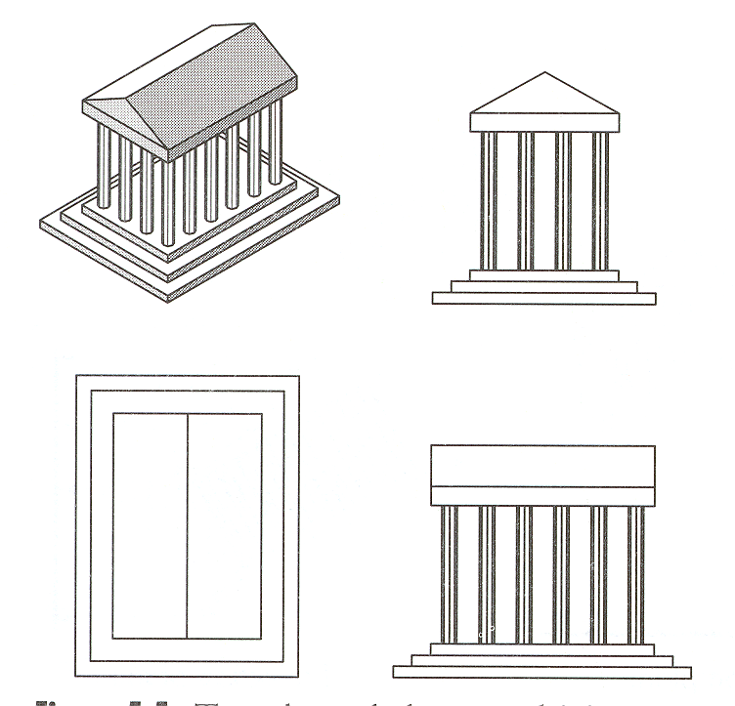
Orthogonal Projections
DOP perpendicular to view plane
Front
Angel Figure 5.5
Top
Side

Slide 17
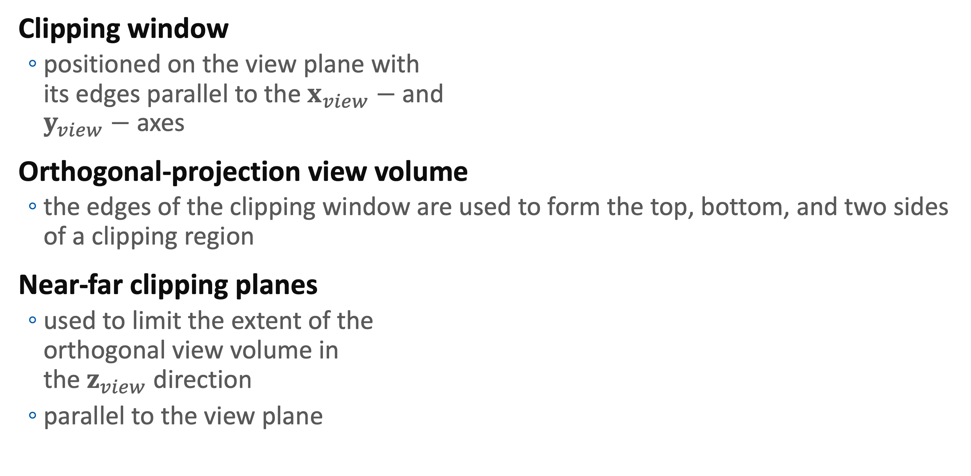
Clipping Window and Orthogonal-Projection View Volume
View plane
Clipping window
positioned on the view plane with its edges parallel to the $x_{view}−$ and $y_{view}−$ axes
Orthogonal-projection view volume
the edges of the clipping window are used to form the top, bottom, and two sides of a clipping region
Near-far clipping planes
used to limit the extent of the orthogonal view volume in the $z_{view}$ direction
parallel to the view plane
y_{view}
Clipping Window
(xw_{max}, yw_{max})
(xw_{min}, yw_{min})
z_{view}
x_{view}
Orthogonal-Projection View volume
Far plane
Clipping Window
Near plane

Slide 18
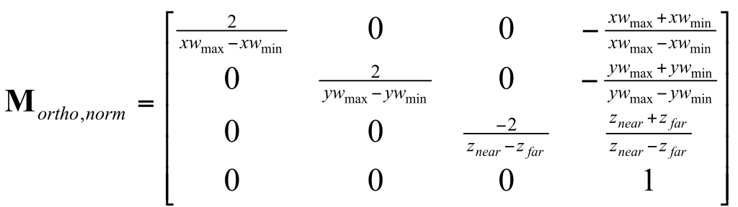
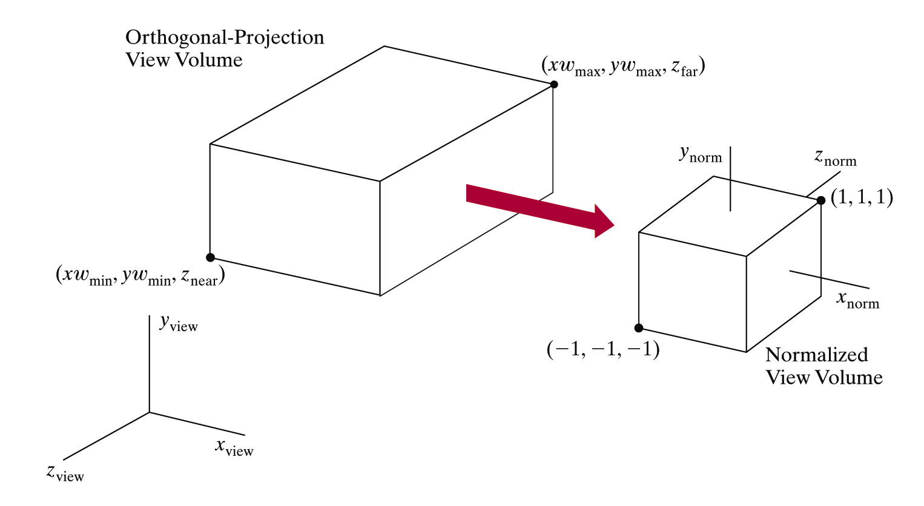
Normalized View Volume
Each of the x, y, and z coordinates is normalized in the range from 0 to 1 or -1 to 1
Device-independent coordinates

Slide 19
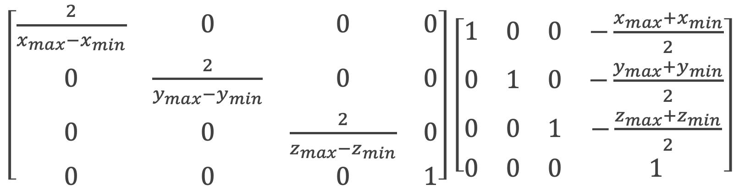
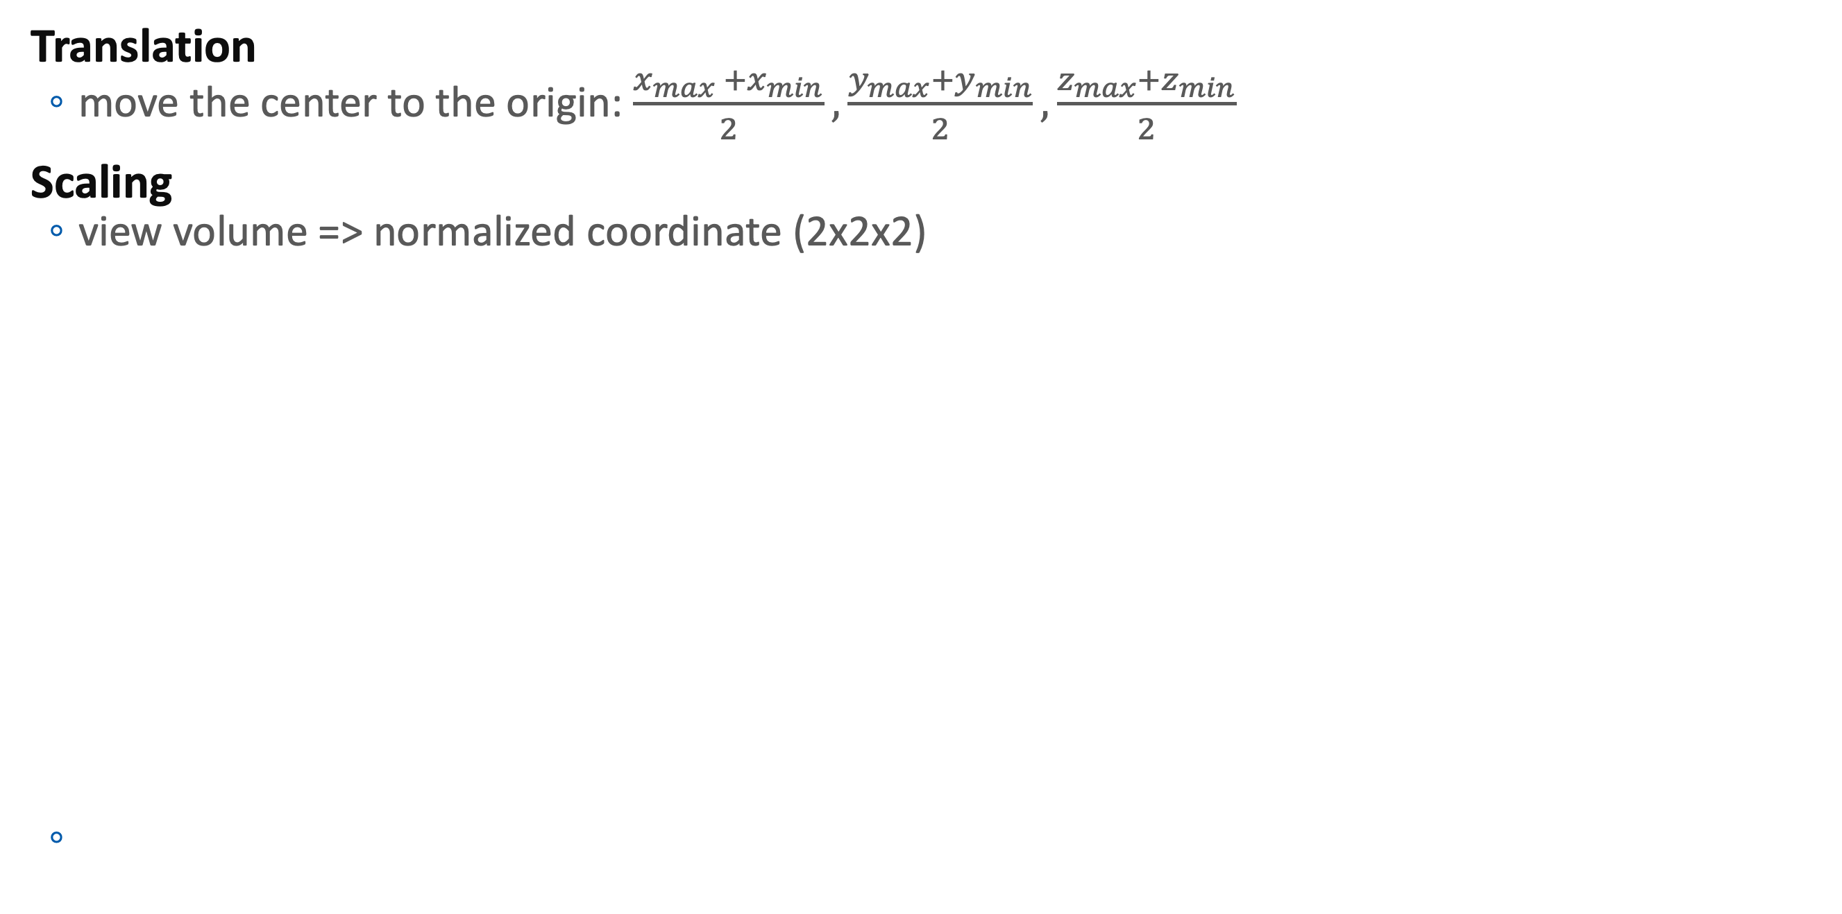
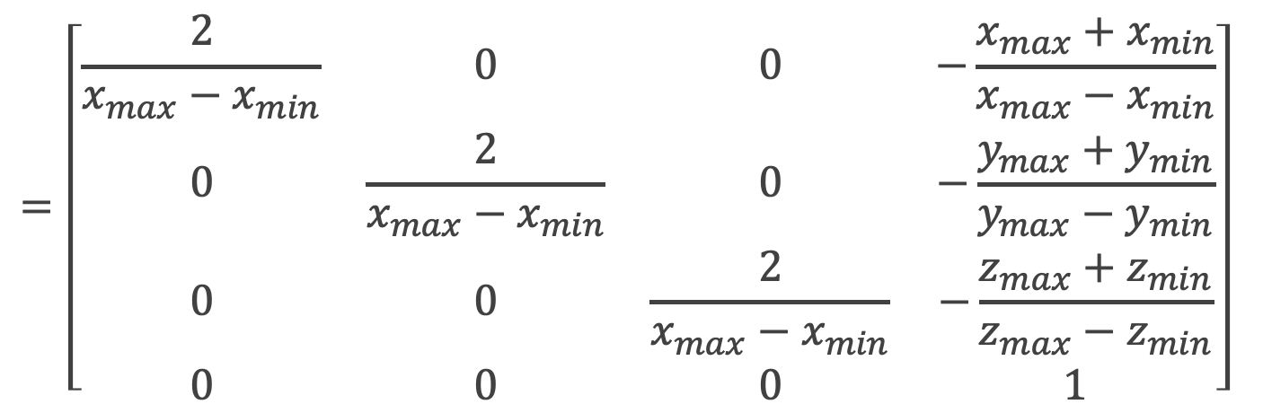
Orthogonal Projection
Translation
move the center to the origin: $\frac{x_{max} +x_{min}}{2}, \frac{y_{max}+y_{min}}{2}, \frac{z_{max}+z_{min}}{2}$
Scaling
view volume => normalized coordinate (2x2x2)
$\left[\begin{matrix}\frac{2}{x_{max}−x_{min}} & 0 & 0 & 0 \\ 0 & \frac{2}{y_{max}−y_{min}} & 0 & 0 \\ 0 & 0 & \frac{2}{z_{max}−z_{min}} & 0 \\ 0 & 0 & 0 & 1\end{matrix}\right]$ $\left[\begin{matrix}1 & 0 & 0 & −\frac{x_{max}+x_{min}}{2} \\ 0 & 1 & 0 & −\frac{y_{max}+y_{min}}{2} \\ 0 & 0 & 1 & −\frac{z_{max}+z_{min}}{2} \\ 0 & 0 & 0 & 1\end{matrix}\right]$
$$=\left[\begin{matrix}\frac{2}{x_{max}−x_{min}} & 0 & 0 & −\frac{x_{max}+x_{min}}{x_{max}−x_{min}} \\ 0 & \frac{2}{x_{max}−x_{min}} & 0 & −\frac{y_{max}+y_{min}}{y_{max}−y_{min}} \\ 0 & 0 & \frac{2}{x_{max}−x_{min}} & −\frac{z_{max}+z_{min}}{z_{max}−z_{min}} \\ 0 & 0 & 0 & 1\end{matrix}\right]$$

Slide 20
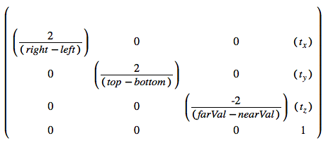
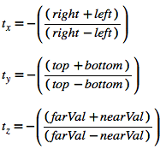
In Practice
glm::ortho( left, right, bottom, top, near, far )
Real example
glm::mat4 projMat = glm::ortho( l, r, b, t, n, f );
glUniformMatrix4(… value_ptr(projMat) )

Slide 21
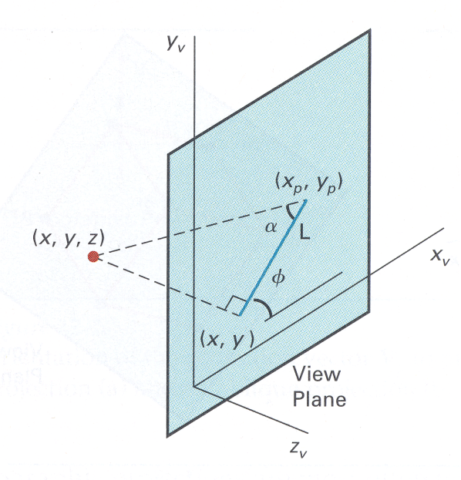
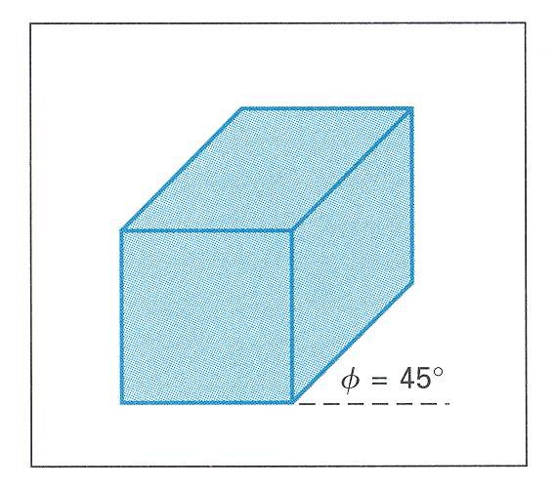
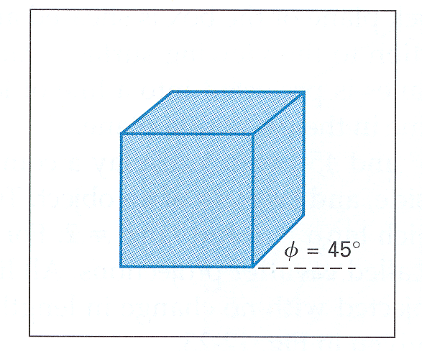
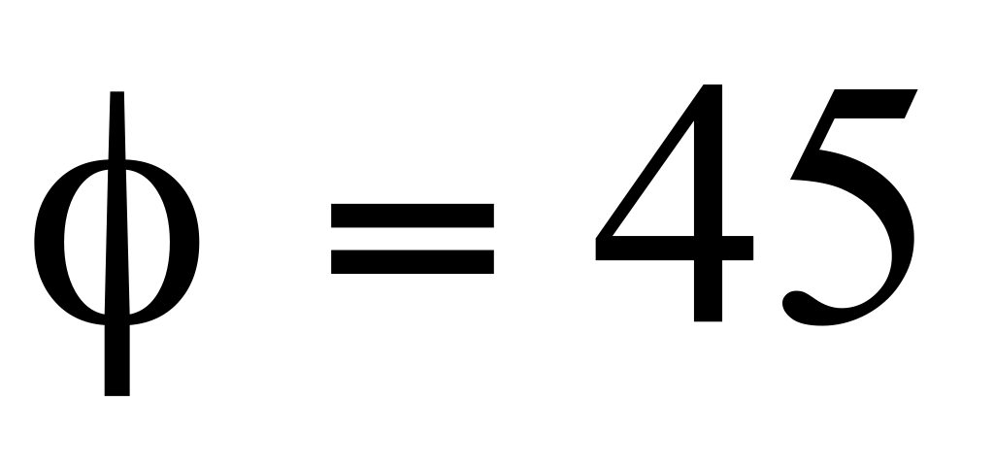
Oblique Projections
DOP not perpendicular to view plane
Cavalier
(DOP α = 45º)
tan(α) = 1
Cabinet
(DOP α = 63.4º)
tan(α) = 2

Slide 22
Oblique Parallel-Projection
Oblique View Volume
Transformed View Volume

Slide 23
Oblique Parallel-Projection
Oblique View Volume
Transformed View Volume

Slide 24
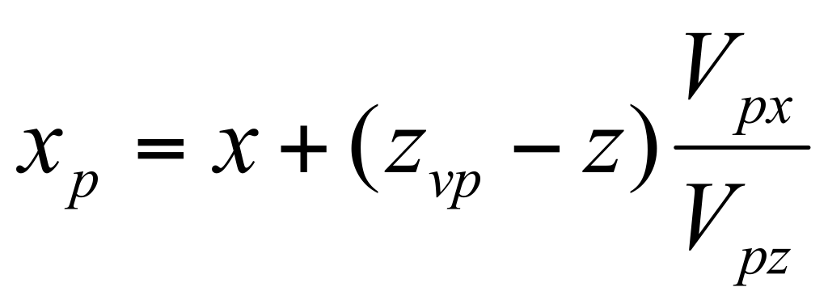
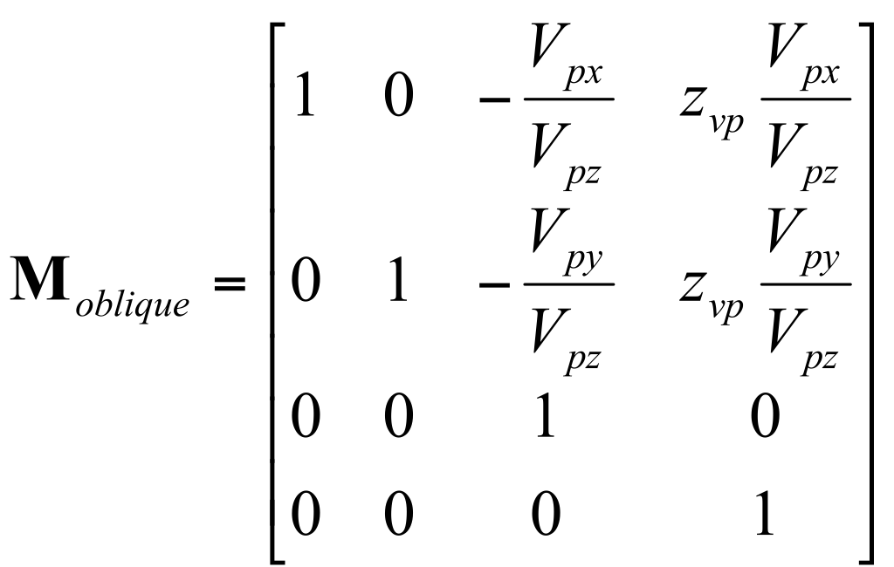
Transformation Matrix
V_{p}

Slide 25
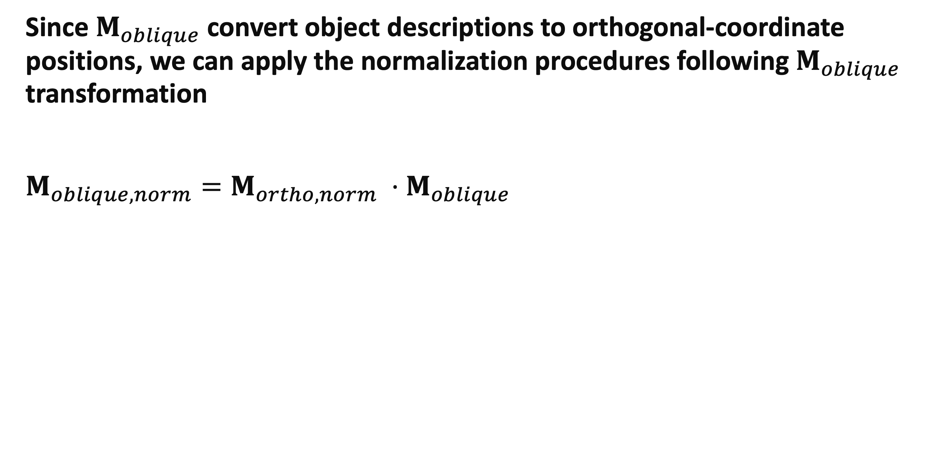
Normalization Transformation for an Oblique Parallel Projection
Since $M_{oblique}$ convert object descriptions to orthogonal-coordinate positions, we can apply the normalization procedures following $M_{oblique}$ transformation
$M_{oblique,norm}=M_{ortho,norm} ⋅M_{oblique}$

Slide 26
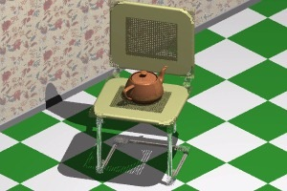
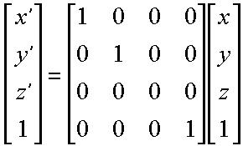
Orthogonal Projection
Simple Orthogonal Transformation

Slide 27
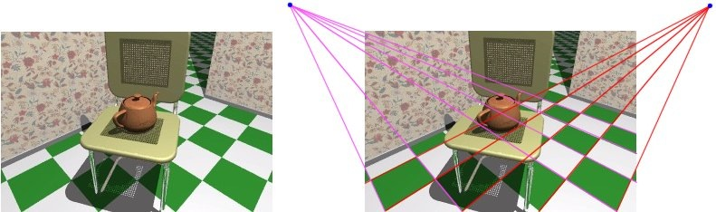
Perspective Transformation
First discovered by Donatello, Brunelleschi, and DaVinci during Renaissance
Objects closer to viewer look larger
Parallel lines appear to converge to single point (vanishing point)

Slide 28
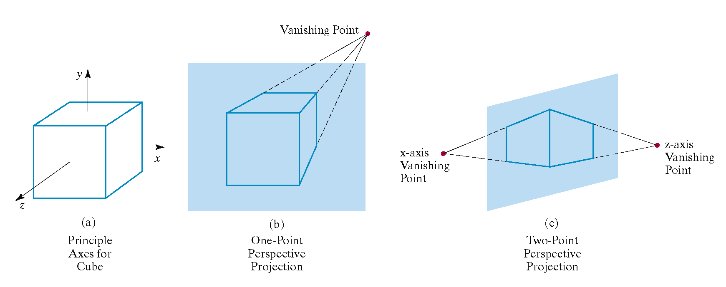
Principal Vanishing Point
Vanishing point for a set of lines that are parallel to one of the principal axes
# of vanishing points (one, two, or three) is equal to # of principal axes that intersect the view plane

Slide 29
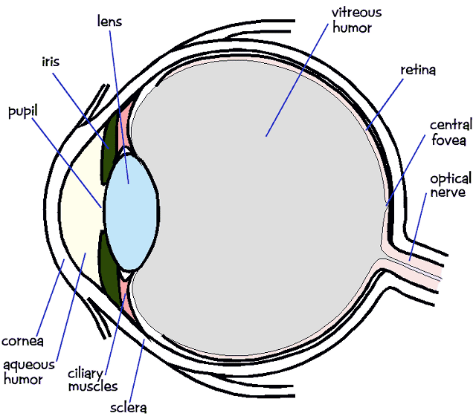
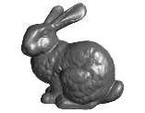
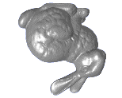
Perspective Projection
In the real world, objects exhibit perspective foreshortening: distant objects appear smaller
The basic situation:

Slide 30
Perspective Projection
When we do 3-D graphics, we think of the screen as a 2-D window onto the 3-D world:
How tall should this bunny be?

Slide 31
Perspective Projection
The geometry of the situation is that of similar triangles. View from above:
What is x' ?
X
View plane
P (x, y, z)
(0,0,0)
x' = ?
Z
d

Slide 32
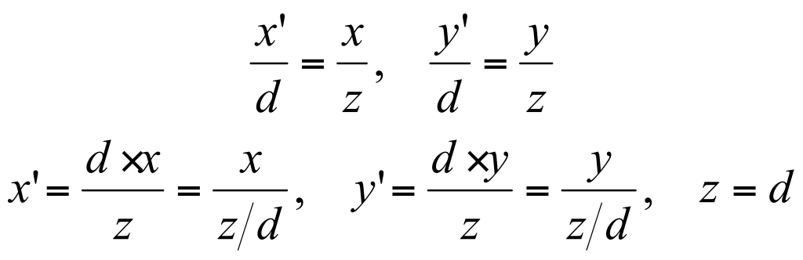
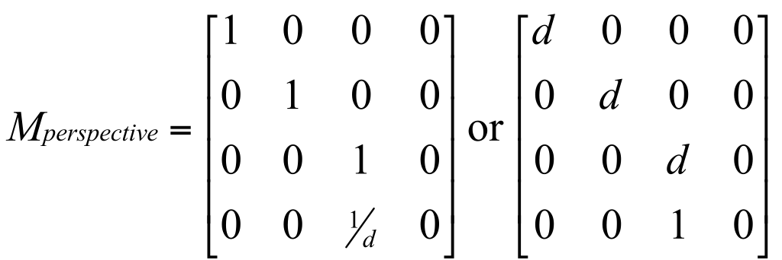
Perspective Projection
Desired result for a point [x, y, z, 1]^{T} projected onto the view plane:

Slide 33
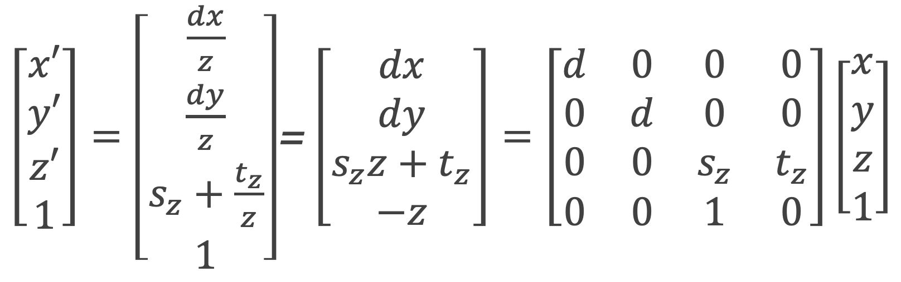
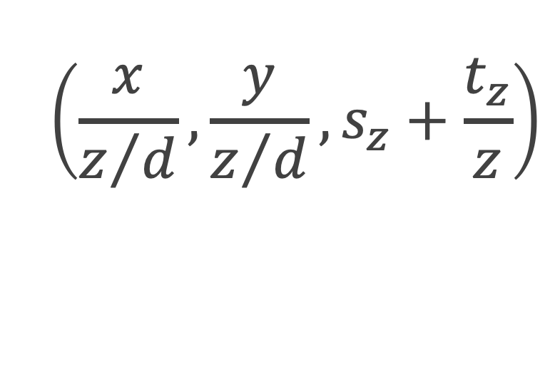
Perspective Projection Matrix
Example:
Or, in 3-D coordinates:
$\left[\begin{matrix}x′ \\ y′ \\ z′ \\ 1\end{matrix}\right]=$ $\left[\begin{matrix}\frac{dx}{z} \\ \frac{dy}{z} \\ s_{z}+\frac{t_{z}}{z} \\ 1\end{matrix}\right]$= $\left[\begin{matrix}dx \\ dy \\ s_{z}z+t_{z} \\ −z\end{matrix}\right]=\left[\begin{matrix}d & 0 & 0 & 0 \\ 0 & d & 0 & 0 \\ 0 & 0 & s_{z} & t_{z} \\ 0 & 0 & 1 & 0\end{matrix}\right]\left[\begin{matrix}x \\ y \\ z \\ 1\end{matrix}\right]$
$$\left(\frac{x}{z/d},\frac{y}{z/d},s_{z}+\frac{t_{z}}{z}\right)$$

Slide 34
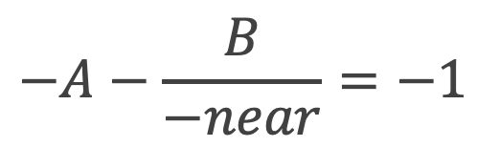
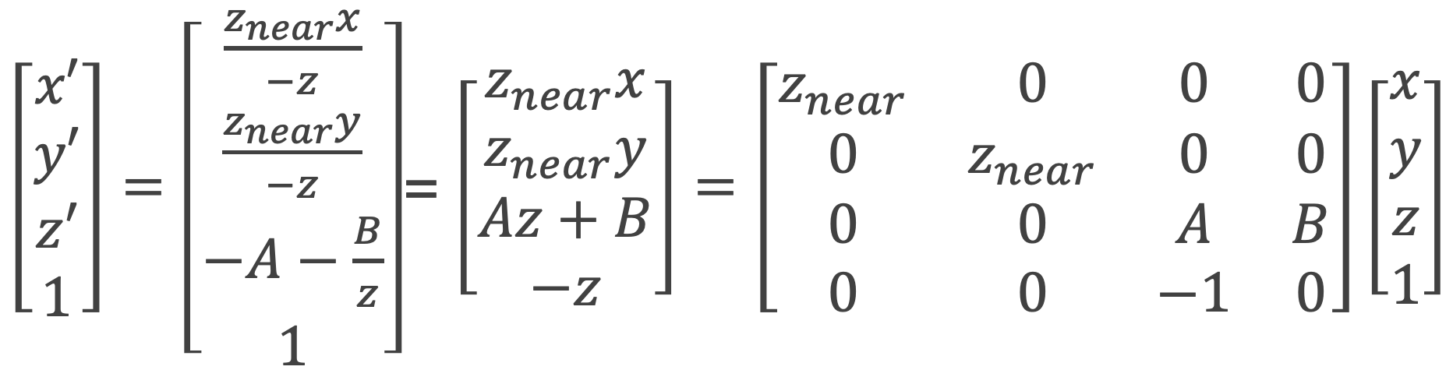
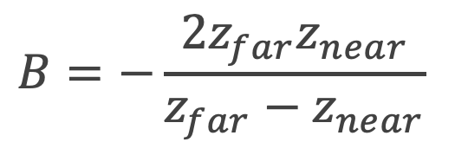
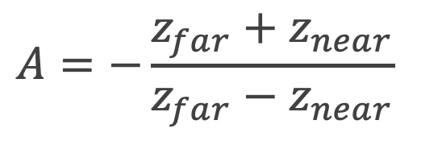

Perspective Projection Matrix
In Practice:
z-value is negative, z-value [-z_{near}, -z_{far}]=> [-1,1]
if z = -z_{near}, z’ = -1
if z = -z_{far}, z’ = 1
$\left[\begin{matrix}x′ \\ y′ \\ z′ \\ 1\end{matrix}\right]=$ $\left[\begin{matrix}\frac{z_{near}x}{−z} \\ \frac{z_{near}y}{−z} \\ −A−\frac{B}{z} \\ 1\end{matrix}\right]$= $\left[\begin{matrix}z_{near}x \\ z_{near}y \\ Az+B \\ −z\end{matrix}\right]=\left[\begin{matrix}z_{near} & 0 & 0 & 0 \\ 0 & z_{near} & 0 & 0 \\ 0 & 0 & A & B \\ 0 & 0 & −1 & 0\end{matrix}\right]\left[\begin{matrix}x \\ y \\ z \\ 1\end{matrix}\right]$
$$−A−\frac{B}{−near}=−1$$
$$−A−\frac{B}{−far}=1$$
$$A=−\frac{z_{far}+z_{near}}{z_{far}−z_{near}}$$
$$B=−\frac{2z_{far}z_{near}}{z_{far}−z_{near}}$$

Slide 35


Perspective-Projection View Volume
Defined by specifying the position of a clipping window on the view plane
bounding planes (bottom, top, and sides) are not parallel
Frustum view volume
add near and far clipping planes that are perpendicular to the $z_{view}−$ axis

Slide 36

View Volume Mapping
A symmetric frustum view volume is mapped to an orthogonal parallelepiped by a perspective-projection transformation

Slide 37






Normalized View Volume
(xw_{min}, yw_{min}, z_{near}) → (-1, -1, -1)
(xw_{max}, yw_{max}, z_{far}) → (1, 1, 1)
$$\left[\begin{matrix}\frac{2}{x_{max}−x_{min}} & 0 & 0 & 0 \\ 0 & \frac{2}{y_{max}−y_{min}} & 0 & 0 \\ 0 & 0 & 1 & 0 \\ 0 & 0 & 0 & 1\end{matrix}\right]\left[\begin{matrix}z_{near} & 0 & C & 0 \\ 0 & z_{near} & D & 0 \\ 0 & 0 & A & B \\ 0 & 0 & −1 & 0\end{matrix}\right]$$
$$C=−\frac{x_{max}+x_{min}}{x_{max}−x_{min}}$$
$$D=−\frac{y_{max}+y_{min}}{y_{max}−y_{min}}$$
$$A=−\frac{z_{far}+z_{near}}{z_{far}−z_{near}}$$
$$B=−\frac{2z_{far}z_{near}}{z_{far}−z_{near}}$$

Slide 38


In Practice
glm::frustum( left, right, bottom, top, near, far )
glm::mat4 projMat = glm:: frustum( l, r, b, t, n, f );
glUniformMatrix4(…value_ptr(projMat));

Slide 39
In Practice
glm::perspective( fovy, aspect, near, far )
glm::mat4 projMat = glm:: perspective( 60*3.1415/180, width/(float)height, 0.1, 100 );
glUniformMatrix4(… value_ptr(projMat) )
fH: tan( fovy/2 ) * near
fW: fH*aspect
frustum( -fW, fW, -fH, fH, near, far )

Slide 40
In Vertex Shader
uniform mat4 viewMat;
uniform mat4 projMat;
uniform mat4 modelMat;
out vec3 posWorld;
out vec3 posCamera;
void main(void) {
vec4 worldPos = modelMat*vec4(in_Position, 1.0);
gl_Position= projMat*viewMat*worldPos;
posWorld = worldPos.xyz;
posCamera = (viewMat*worldPos).xyz;
}

Slide 41
Projection Demo
Implementation
int width, height;
glfwGetFramebufferSize( window, &width, &height );
glViewport( 0, 0, width, height );
…
GLuint loc;
loc = glGetUniformLocation( program.programID, "projMat" );
mat4 projMat = perspective( cameraFov/180.f*3.1415926535f, width/(float)height, 0.01f, 100.f);
glUniformMatrix4fv(loc, 1, 0, value_ptr(projMat));

Slide 42

Clipping
Procedure that eliminates those portions of a picture that are either inside or outside of a specified region of space
Clipping in the viewing pipeline
extract a designated portion of a scene (clipping window) for display on an output device
everything outside the clipping window is then eliminated from the scene description
Clipping is usually applied in the normalized coordinates
it reduces calculations because all geometric and viewing transformation matrices can be concatenated and applied to a scene description before clipping is carried out

Slide 43



Assignment #3
3D Viewer
Mouse-horizontal drag: camera orbiting around y-axis
Mouse-vertical drag: camera pitch (Keep looking at the origin)
-PI/2+0.01 < pitch angle < PI/2-0.01
Mouse-wheel motion: camera fov change
10˚ ≤ fov ≤ 170˚

Slide 44
Questions?

